Slide 2


Slide 3
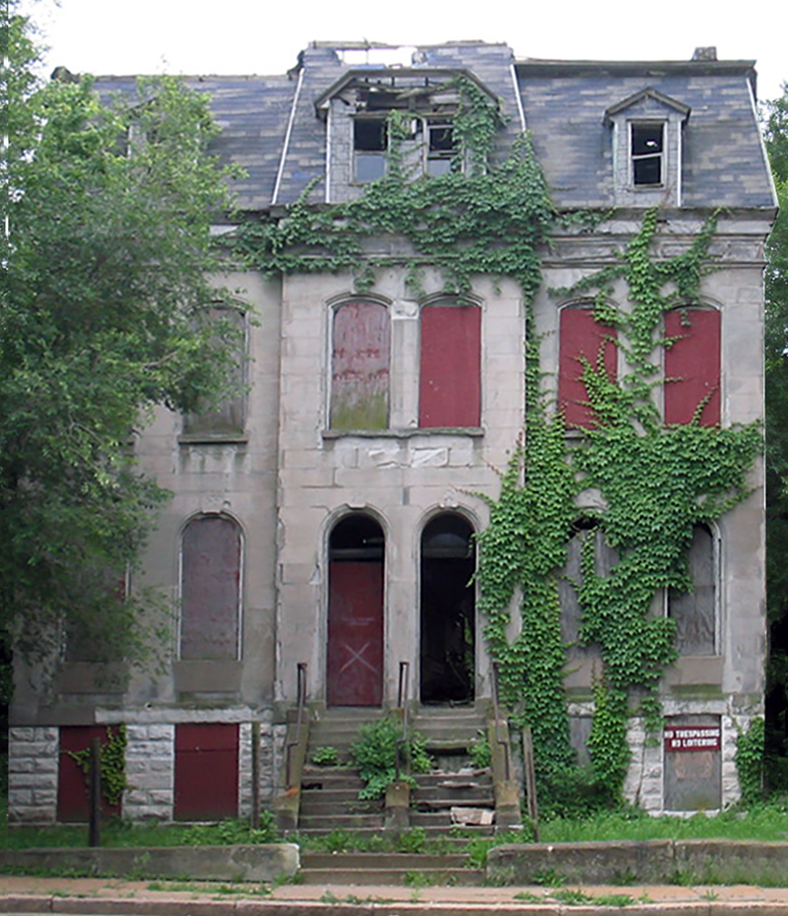

Slide 4
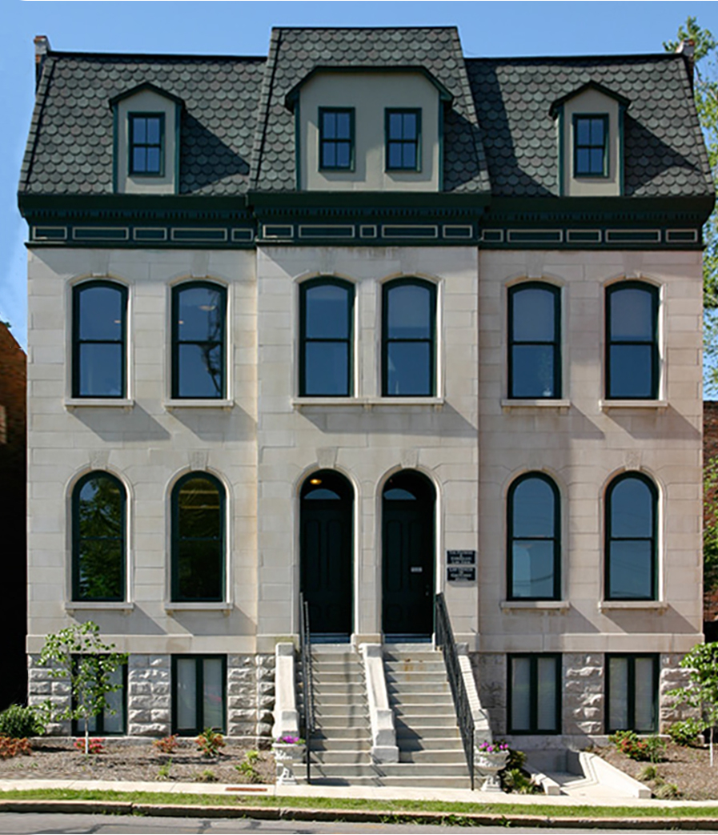

Slide 5
EXPLORING the Future of St. LOUIS THROUGH DATA
by Ronaldo Migliorini, Nathanuel Martin & Katherine Comfort-Mason

Slide 6
St. Louis is rich in culture, innovation, and history. With a central location and low cost of living, it ought to be an attractive destination for businesses and families alike — but decades of decline make would-be residents understandably wary.
In recent years, however, ambitious homeowners and entrepreneurs have transformed crumbling, desolate areas into vibrant communities where our city’s future shines brighter than ever. So, where is the next smart investment?
We have explored St. Louis’ 79 neighborhoods to determine which offers the greatest potential for revitalization, comparing:
quantity of unoccupied residential properties
crime statistics
prevalence of historic homes

Slide 7
By identifying which neighborhoods have the greatest quantity of available properties, the lowest rates of violent crime, and the greatest historical significance, we hope to predict the next Lafayette Square or Tower Grove!

